Slide 1


Team 50: Remote Biometric System
Final Presentation Simon Becker
Andrew-Joseph Nicolas
Lance Pagaduan
Harin Sankar Sponsor: Dr. Steven Wright TA: Hailey Ward

Slide 2
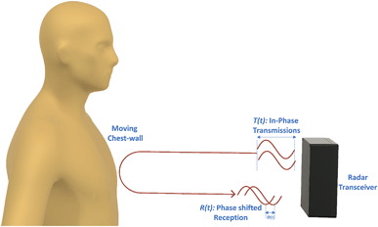
Contactless Cardiac Gating
Extensive and uncomfortable prep can be necessary
MRI Patient throughput can be improved
32% of patients think they wait too long for MRIs¹
Vasireddy, Rakesh & Roth, Corinne & Mathis, Johannes & Goette, Josef & Jacomet, Marcel & Vogt, Andreas. (2018). K-band Doppler radar for contact-less overnight sleep marker assessment: a pilot validation study. Journal of Clinical Monitoring and Computing. 32. 10.1007/s10877-017-0060-9.
Dostál, M., Jurasová, K., Keřkovský, M. et al. What factors affect a patient’s subjective perception of MRI examination. Sci Rep 14, 22731 (2024). https://doi.org/10.1038/s41598-024-74231-9
Notes:
Kyle

Slide 3
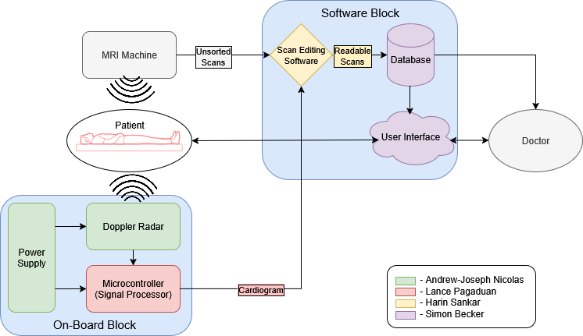
Contactless Cardiac Gating
Notes:
Eric

Slide 4
Radar & MCU
Lance Pagaduan
Design Function
IWR6843AOP (radar) extracts chest movements from the patient in the form of I/Q data. The I/Q values go to the STM32F407 (MCU) housed on the PCB which will calculate heart & respiration rate as well as heart beat trigger signals.
Challenges
Radar connection issues to PC
STM32CubeIDE library & functions configuration issues
Accomplishments
Configured radar to extract chest movements from within a 0.5m range
Coded MCU dev board with sample I/Q data to calculate biometric data and trigger signals
Flashed MCU on PCB with code to output same results as sample data
Notes:
Need to state what formulas and filters I used to code the MCU to calculate biometric data

Slide 5
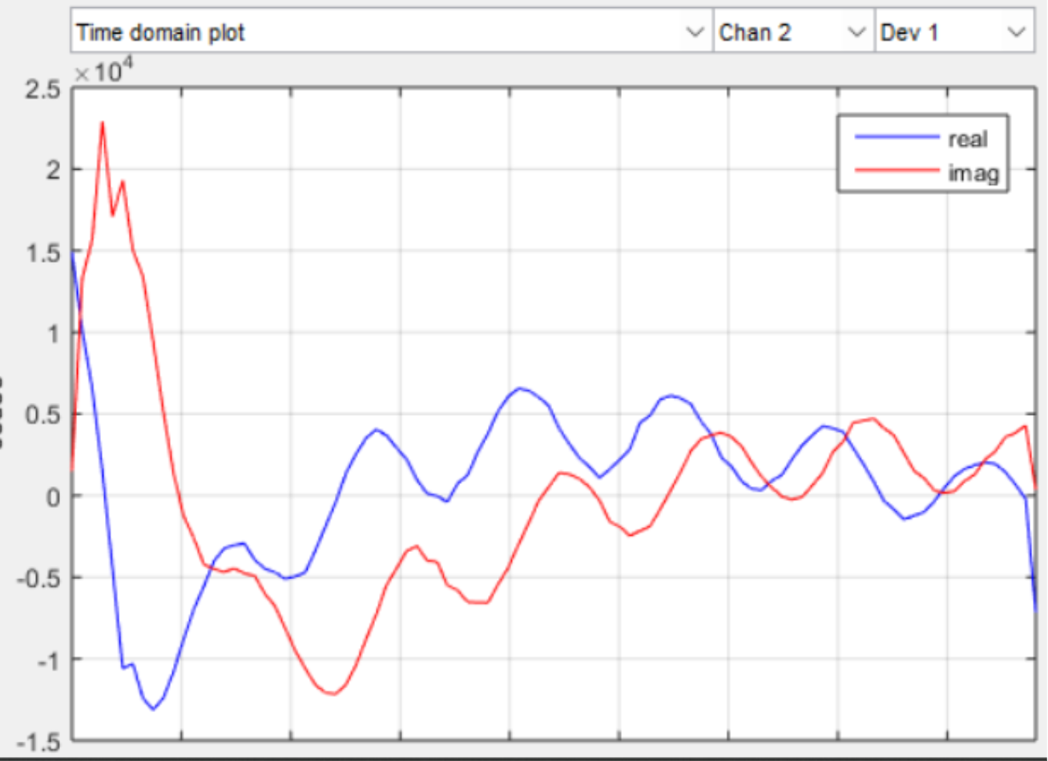
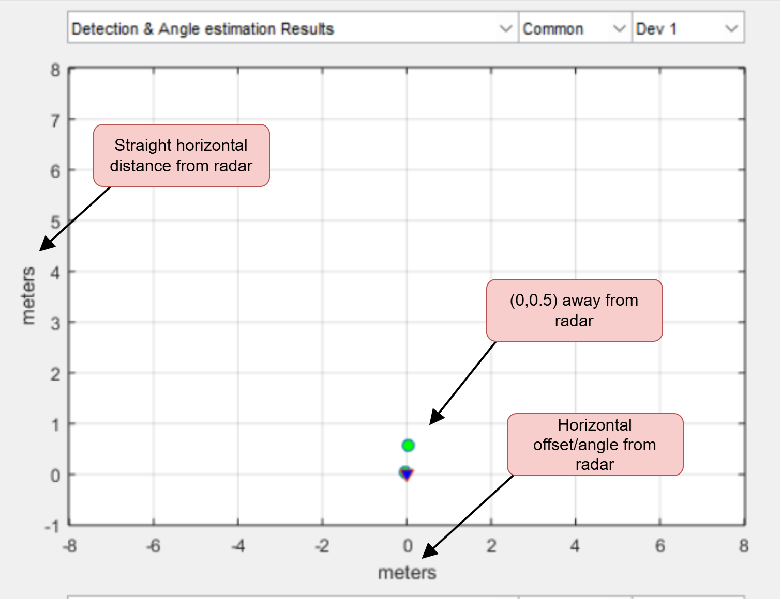
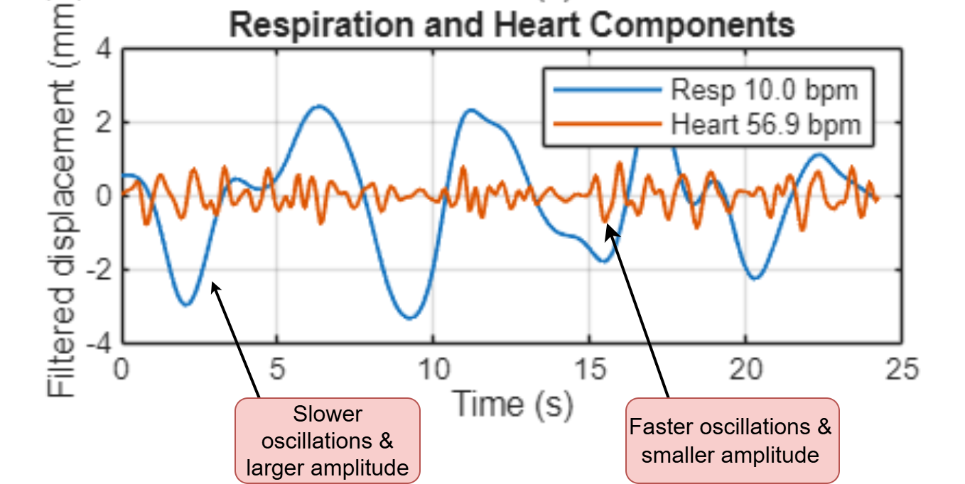
Radar & MCU
Lance Pagaduan
Radar Validation

Slide 6
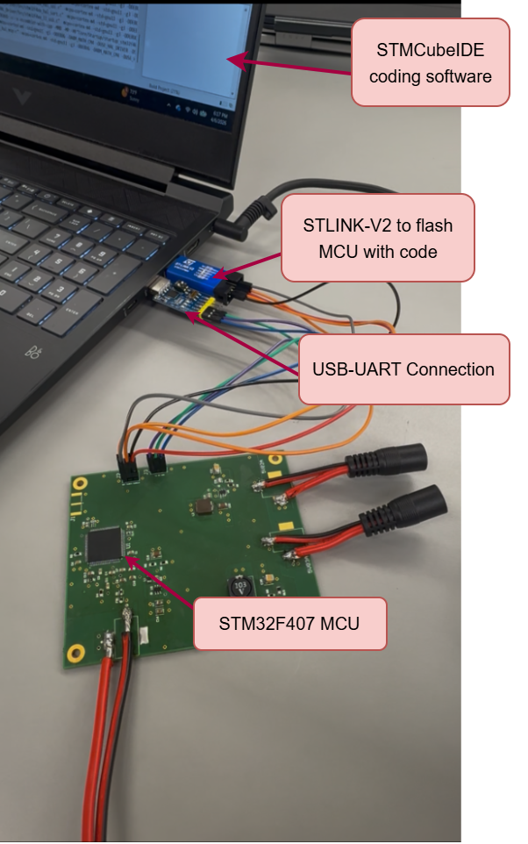
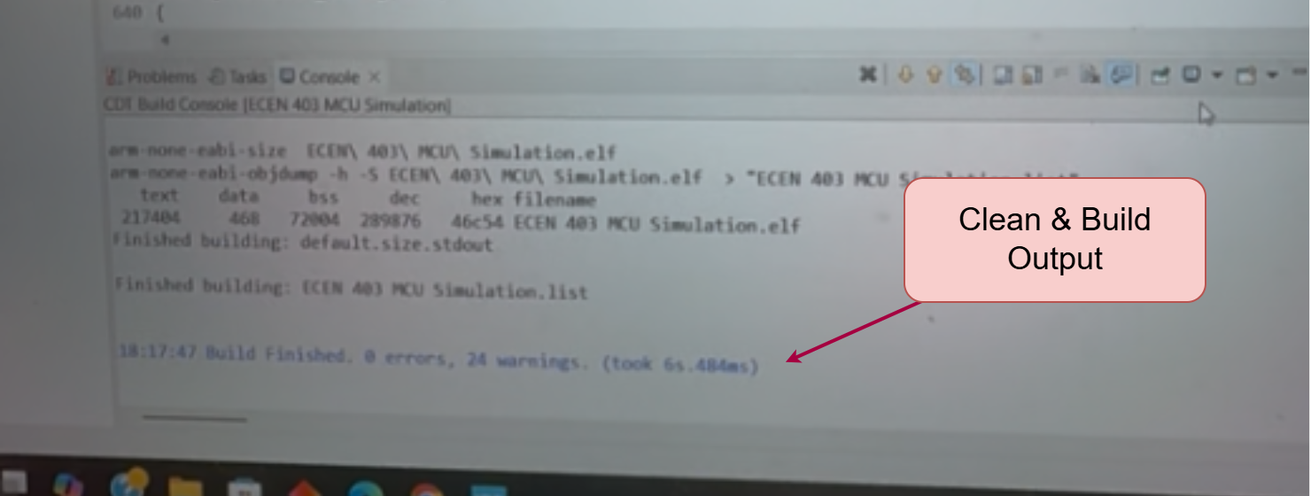
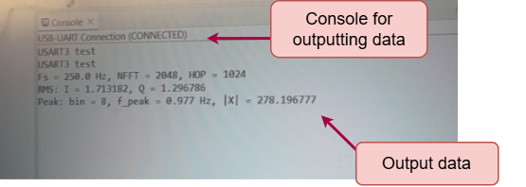
Radar & MCU
Lance Pagaduan
MCU Validation

Slide 7
PCB
Andrew-Joseph Nicolas
Design Function
Three separate DC power rails are maintained on the PCB to deliver power simultaneously during normal operation.
DC Rails:
5V, 3A
5V, 2A
3.3V, 0.5A
The PCB hosts an STM32 microcontroller and provides the ability to communicate data between the board and PC.
Accomplishments
All hardware was powered properly and functional while connected to the PCB.
STM32 was able to communicate effectively over UART.
No power stability or data integrity issues were observed during validation and deployment testing

Slide 8
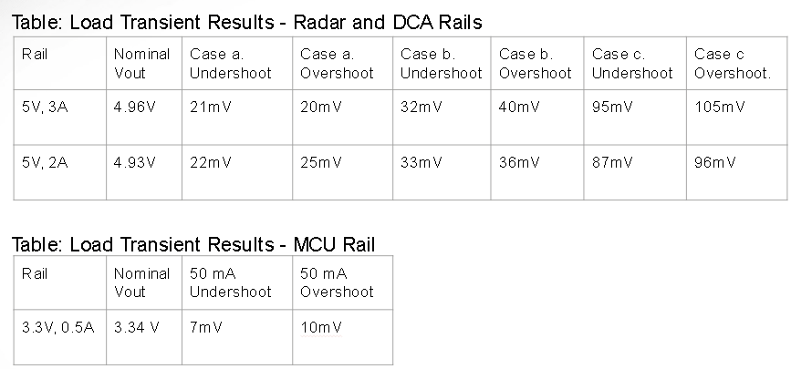
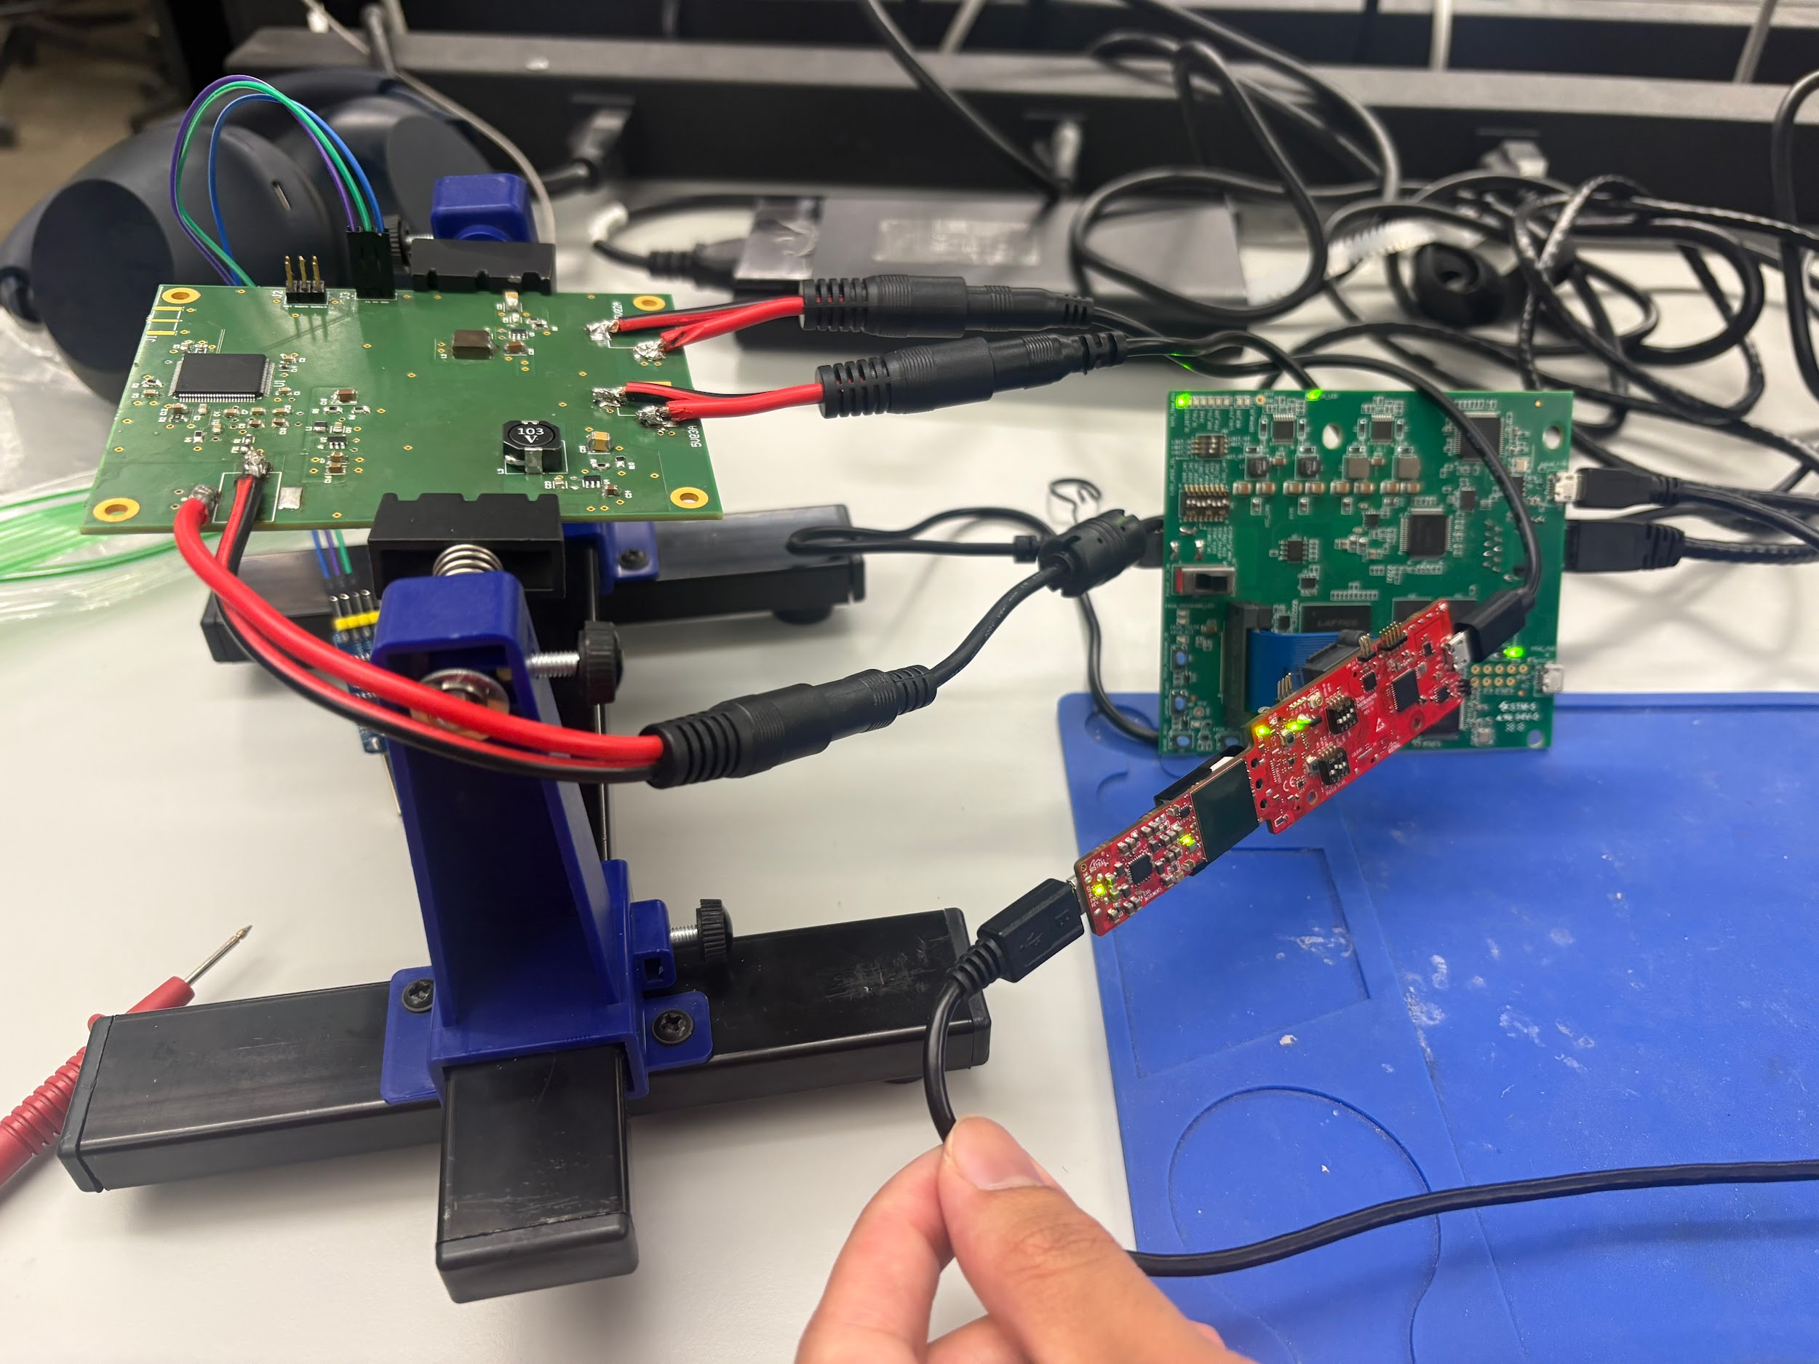
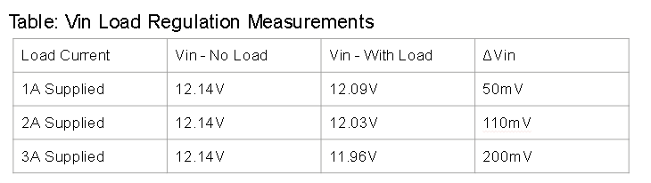
PCB Validation
Andrew-Joseph Nicolas
Cases:
Case a: 0.5A load step
Case b: 0.75A load step
Case c: 1A load step

Slide 9
Scan Filter
Design Function
Python software reads raw MRI acquisition data and a radar-derived cardiac waveform, reconstructs acquisition timing, maps k-space lines to cardiac phase, and removes motion-corrupted data before generating readable output images.
Challenges
Raw MRI data required custom vendor-specific parsing at the acquisition level.
Motion screening had to reject corrupted data while preserving enough k-space coverage for usable reconstruction.
Accomplishments
Synchronized .mrd raw scans and cardiogram data for joint timing-based analysis.
Reconstructed artifact-reduced DICOM images by identifying and replacing motion-corrupted data.
Maintained gating robustness under outlier cardiac waveforms

Slide 10
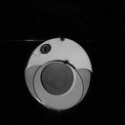
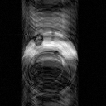
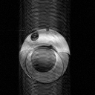
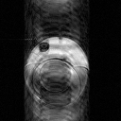
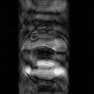
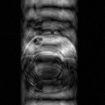
Scan Reconstruction Validation
128 by 128 line k space scan of an orange under motion
Lines 1-23
Lines 24-41
Lines 42-49
Lines 50-78
Lines 79-91
Lines 92-128
Final image with all lines concatenated
Validation | Requirement | Spec / Metric | Result
Image Reconstruction | Reconstruct readable, artifact-reduced images from corrupted scans | SSIM >= 0.90; readable output rate >= 90% | SSIM mean 0.93, 10/10 readable outputs
K-Space Line Usage | Use phase-consistent k-space lines and reject corrupted lines | Line-selection accuracy >= 95%; corrupted-line rejection >= 90% | accuracy mean 98%, rejection mean 91%

Slide 11
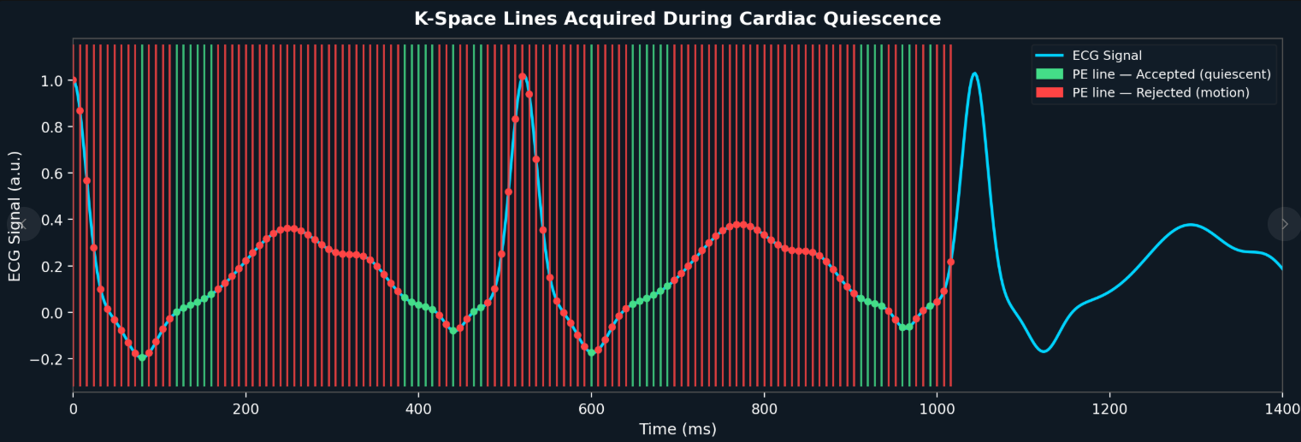
Gating Validation
Synchronization of mri scan readout lines with a 117.6 beats per minute cardiogram
Validation | Requirement | Spec / Metric | Result
K-Space / Cardiogram Synchronization | Correctly align each k-space line with the cardiogram timing | Synchronization Error <= 10 ms; Accuracy >= 95% | Max Error: 5 ms; Accuracy: 97 %
Outlier Cardiogram Handling | Maintain correct gating under irregular cardiogram cases such as arrhythmia | Outlier phase-bin accuracy | 5/5 outlying cardiograms were binned properly with scan data

Slide 12
User Interface
Simon Becker
Engineering Challenges:
Integrating Harin’s Scan Filter with the existing Desktop Application
Using Python.NET framework
Maintaining file security with data transfer

Slide 15
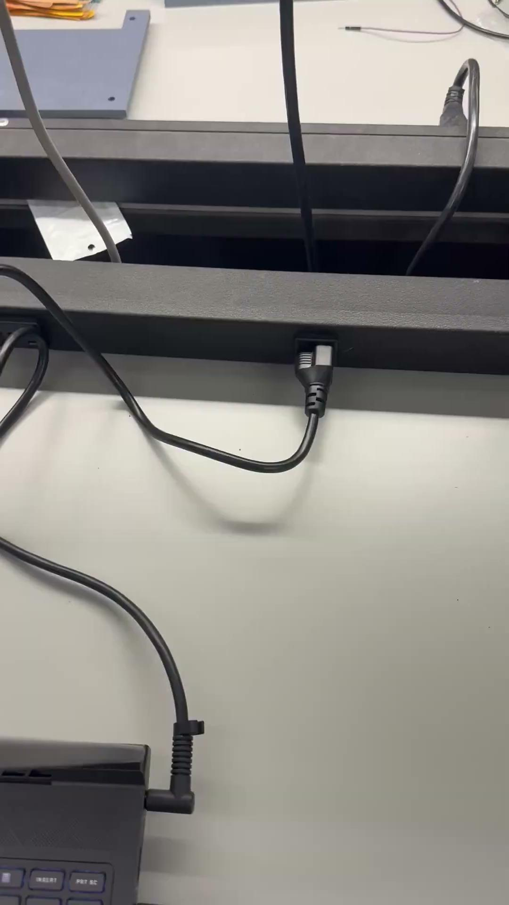
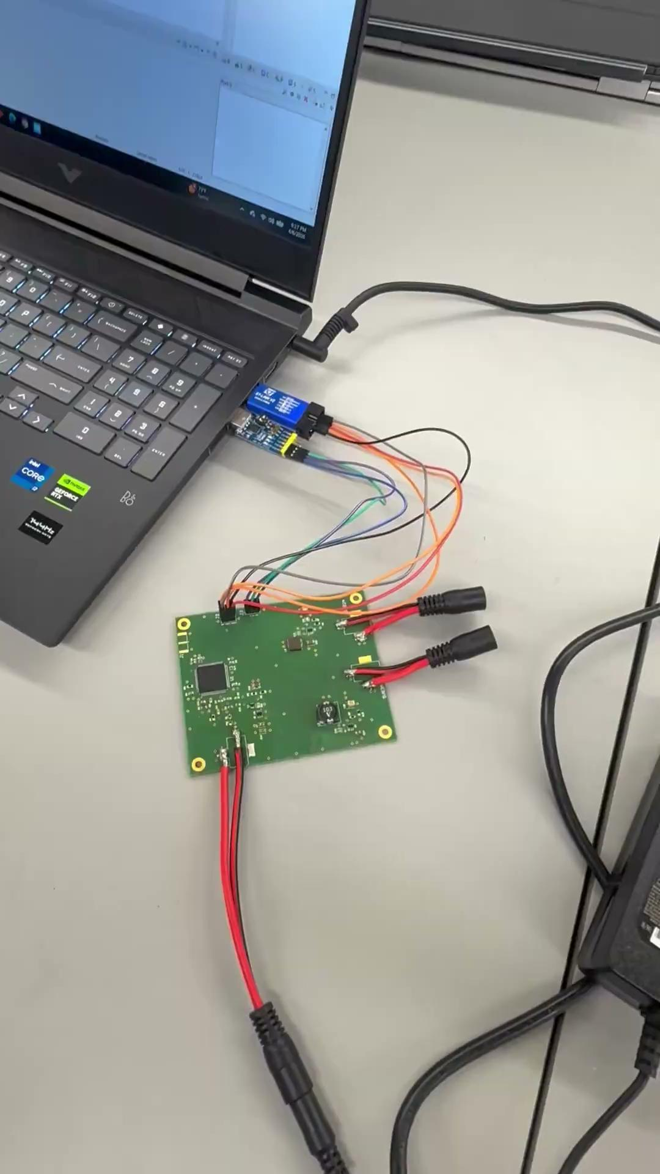
Integrated System Results
Hardware Radar Integration
Hardware MCU Integration

Slide 16
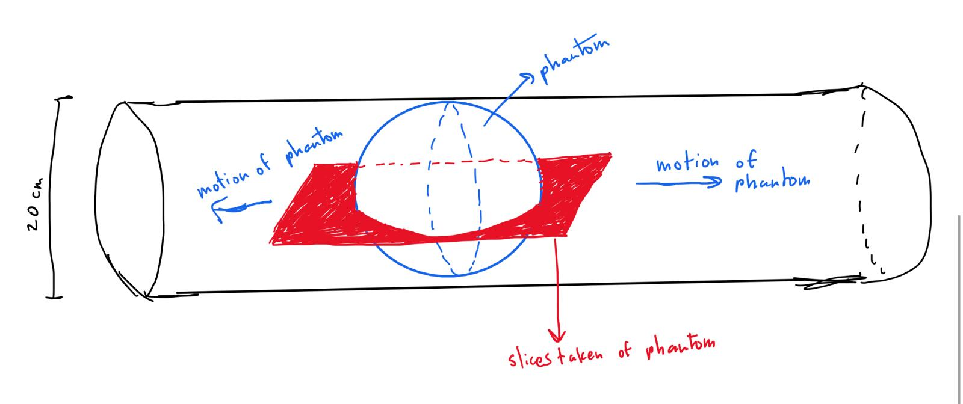
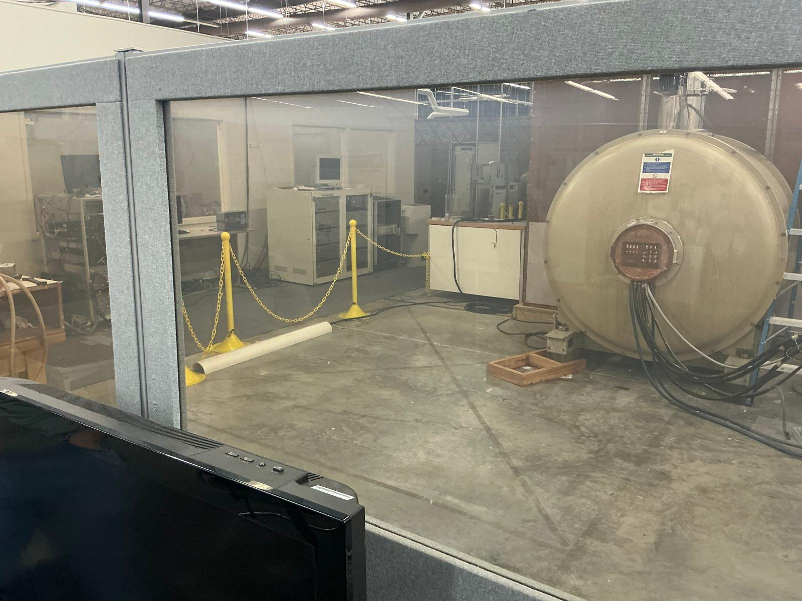
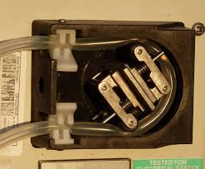
Plans and Challenges for Live Testing

Slide 17
Conclusions
Project Design Changes
Radar AWR2944EVM changed to IWR6843AOP to capture full IQ values
Addition of Data Capture Board to hold more data for longer streaming
Current Status
Need to reconfigure radar to handle 5m due to sponsor request
MCU awaiting to be tested with live IQ data
Testing with live MRI data

